Slide 1
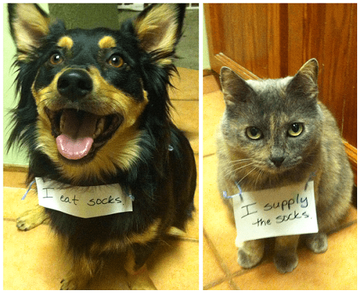
Demand
and Supply

Slide 2
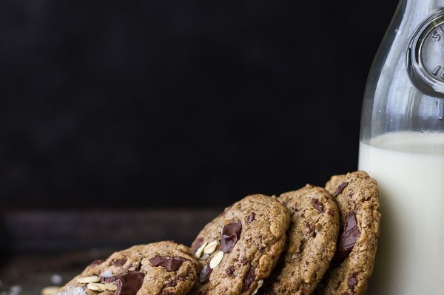
The Law of Demand states there is an inverse relationship between _____________________
of a good buyers are willing to purchase.
Demonstration: What amount of money would you pay to have me deliver a cookie and milk to your seat?

Slide 3

Typical range of prices over which price matters a great deal. (Notice the negative slope.)

Slide 4
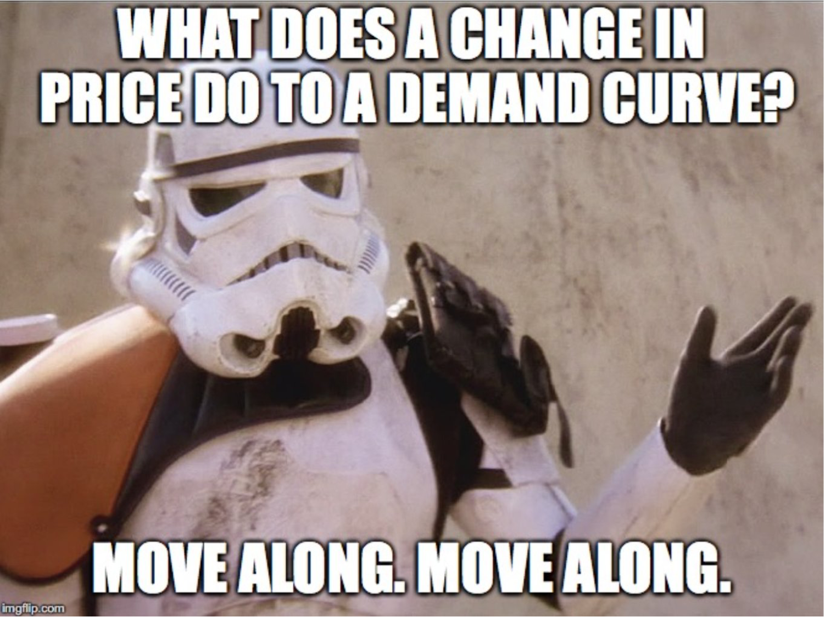

Slide 5


Slide or shift?
Price
25
A movement along a demand curve is a result of a price change alone. This is known as _________.
20
15
10
A shift in the entire curve occurs when something other than the price changes. This is a ________
5
D_{Less}
D
D_{More}
5
10
15
10
15
20
Quantity

Slide 6
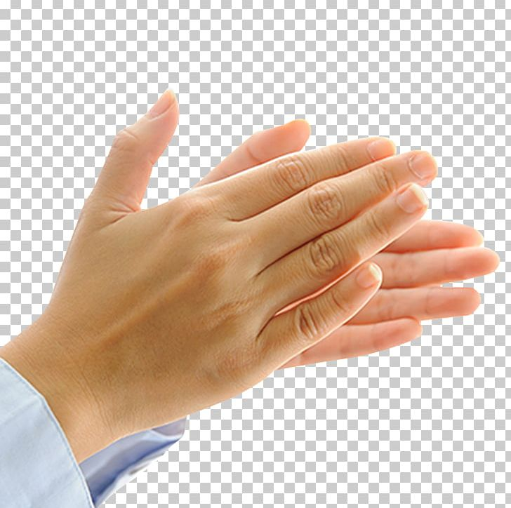



Let’s all practice
Price
Illustrate what happens to ramen demand (an inferior good) when
Your income rises!
End
1
2
3
4
5
6
7
8
9
10
11
12
13
14
15
D
Quantity of ramen noodles

Slide 7
Let’s all practice
Price
Illustrate what happens to hamburger demand when
The price of hot dogs increases!
End
1
2
3
4
5
6
7
8
9
10
11
12
13
14
15
D
Quantity of hamburger

Slide 8
Let’s all practice
Price
Illustrate what happens to toilet paper demand when
The future price of t.p. is expected to rise.
End
1
2
3
4
5
6
7
8
9
10
11
12
13
14
15
D
Quantity of toilet paper

Slide 9
Let’s all practice
Price
Illustrate what happens to sock demand when
The price of socks fall!
End
1
2
3
4
5
6
7
8
9
10
11
12
13
14
15
D
Quantity of socks

Slide 10
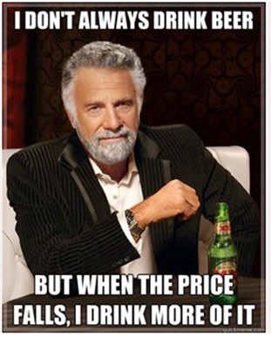
TPS: Discuss this with your teammates.
You work at a restaurant that serves drinks.
Your boss comes to you, knowing you are studying economics, and asks for your opinion on the following question:
Which of the following would change the demand for drinks the most?
a reduction in the price of a complementary good.
a reduction in the price of drinks.
C. both A and B would increase the demand for drinks.
2 minutes

Slide 11

Karma Flowers
The Law of Supply is
the direct relationship between the price and
the amount producers
are willing to sell.
The Law of Demand states there is an inverse relationship between price and the quantity
of a good buyers are willing to purchase.
Increases in price raise the opportunity cost of consuming a good.
Demonstration:

Slide 12
Price
$10,000
Supply
Notice the positive slope.
500
5
0
_{Most}
_{of you!}
Quantity
of singers

Slide 13
Incentives Influence Singing
Price
S _{jail}
S _{in} _{class}
S _{shower or car}
$10,000
500
5
n
Quantity of singers
0

Slide 14
Slide or shift?
Price
S_{Less}
S_{More}
S
25
A movement along a supply curve is a result of a ______________ . This is known as a change in the quantity supplied.
20
15
10
A shift in the entire curve occurs when something other than ________ changes. This is a change in supply.
5
5
10
15
10
15
20
20
25
30
Quantity

Slide 15
Let’s all practice
Price
Illustrate what happens to supply when
S
The minimum wage rises!
End
1
2
3
4
5
6
7
8
9
10
11
12
13
14
15
Quantity

Slide 16
Let’s all practice
Price
illustrate what happens to supply when
S
The price drops!
End
1
2
3
4
5
6
7
8
9
10
11
12
13
14
15
Quantity

Slide 17
Let’s all practice
Price
Illustrate what happens to supply when
S
More sellers enter the market!
End
1
2
3
4
5
6
7
8
9
10
11
12
13
14
15
Quantity

Slide 18
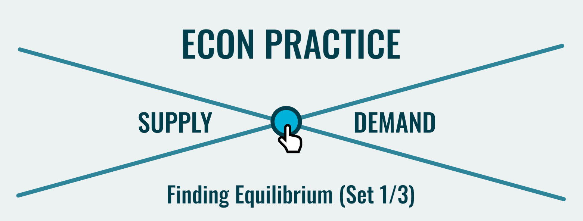
Marginal Revolution University https://practice.mru.org/equilibrium/

Slide 19
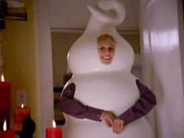
TPS: Dairy Queen Commercial
In the commercial, if the price of the waffle cone piece goes up then the demand for ice cream.
_
In general, If the price of whipped cream rises, what happens to the supply of whipped cream?
_
In general, If the price of the ice cream used in making a blizzard goes up what happens to the supply of blizzards
_

Slide 20

Market Equilibrium
At a given price, quantity demanded is equal to quantity supplied.
Surplus
At a given price, quantity supplied is greater than quantity demanded.
Shortage
At a given a price, quantity demanded is greater than quantity supplied.

Slide 21
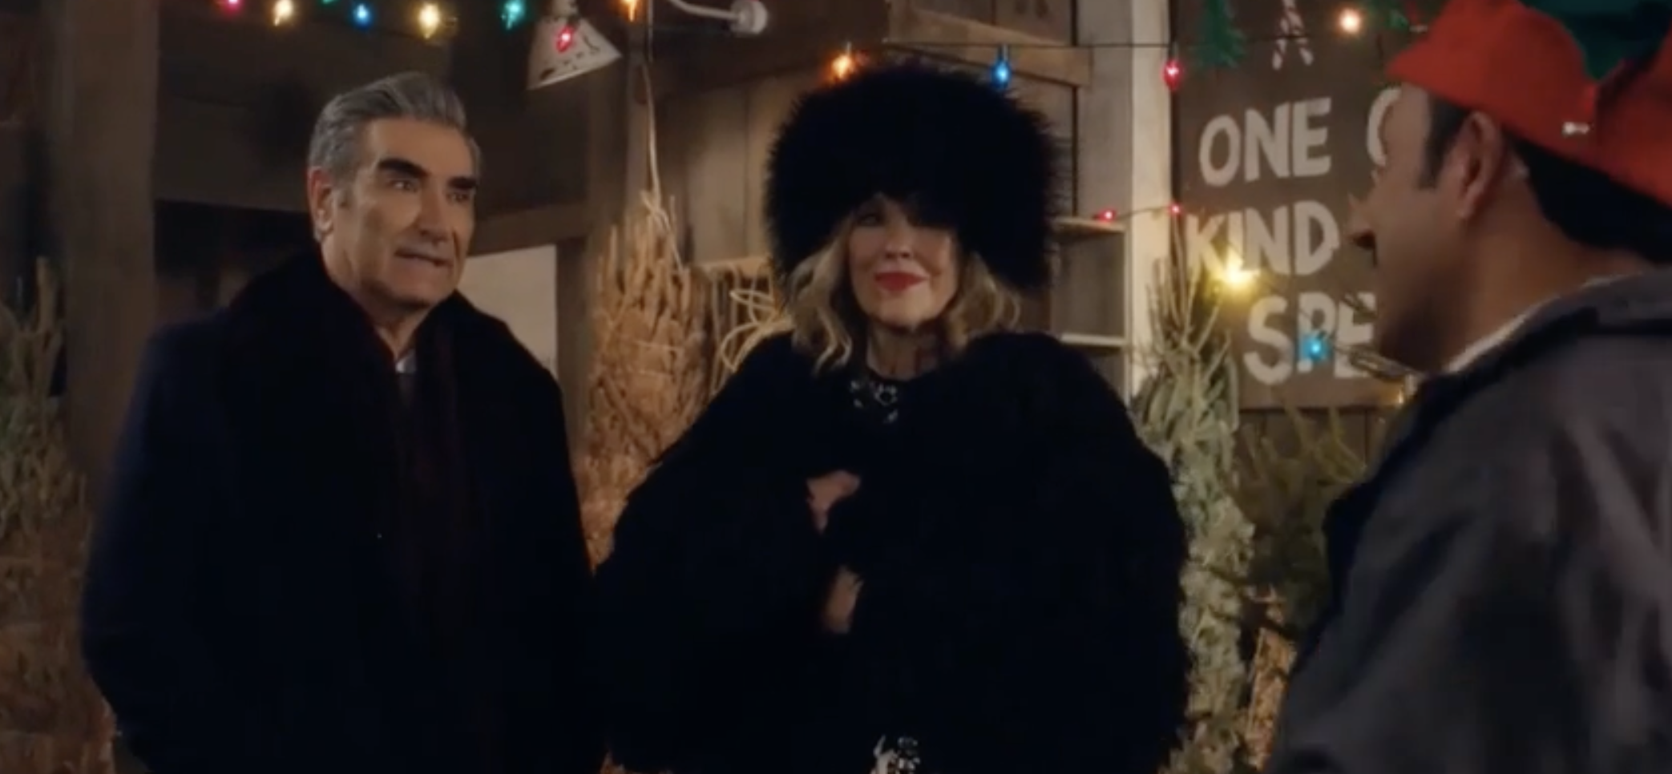
Schitt’s Creek: Christmas Tree Prices right before Christmas

Slide 22
3.3 Market Equilibrium
Surplus puts downward pressure on the price
Market equilibrium: occurs where quantity demanded equals quantity supplied. Can be shown graphically or algebraically: where Q_{d} = Q_{s}
Shortage puts upward pressure on the price

Slide 23
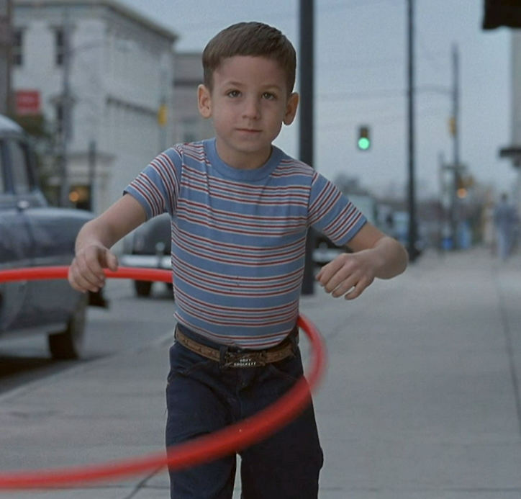
Hudsucker Proxy
What price do you charge for a new product no one has ever seen before?
Markets coordinate prices and eliminate excess
supply (surpluses) and excess demand (shortages).

Slide 24
Hudsucker Proxy
S
Price
new equilibrium price
3.99
1.79
D₂
free
Quantity
original equilibrium price
D₁

Slide 25

Graphs & Algebra
P_{d} = 150 – 3Q (demand)
P_{s} = 6 + 3Q (supply)
Graph
Find equilibrium
At a price of $72, find the amount of the shortage or surplus.

Slide 26

What happens
to price and quanity when both supply and demand change?

Slide 27
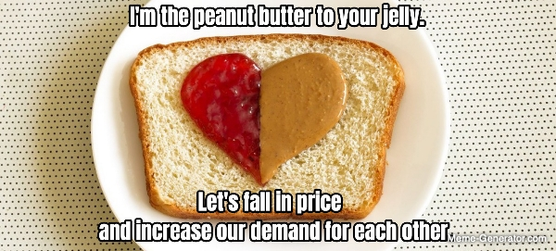
TPS:
Is this meme correct?

